Slide 1
Development & Impact of Middle School Computer Science Saturday Outreach
Presenter: Veronica Cateté
Committee: Tiffany Barnes, Kristy Boyer, Harry Perros
Notes:
----- Meeting Notes (9/24/14 15:27) -----
Make beautiful, font choices, align page number.
Avoid upward inflections at end of sentence
More numbers, survey data,
Lit review, references.
Name, Date, all publications on last slide.

Slide 2

Overview
Motivation: Broadening Participation
SPARCS: CS Saturday Program
Related research
Evolution of Curriculum
Results: SPARCS kids take HS computing

Slide 3
Motivation
The U.S. Department of labor estimates that by 2020 there will be more than 1.4 million computing-related job openings
At current bachelor degree graduation rates, we can only fill ~30% of those

Slide 4


High school trends
Students in high School: 16 million
Students who will be graduating seniors: 3.2 Million
Students who will choose Computing majors: 96,000 or 3%
This group of students will have the composition of 5 boys for every 1 girl
Notes:
This arm is about 6%, and is double computer science
Totals
Eng: 7%
Buis: 23%
Hum: 12.5%
S&M: 8%
Soc Sci: 16%
Education: 7.5%
Health Care: 6%
Other: 15
Men
Engineering 12%
Business 27%
Humanities 12%
Bio & Phys Science +Math 9%
Women
Engineering 2%
Business 19%
Humanities 13%
Bio & Phys Science +Math 7%
http://www.bgwomeninict.org/language/bg/uploads/files/documents__0/documents__83629f0d73af0b954068af2b53b04dc5.pdf pg 14

Slide 5
Interest is Important
Research suggests
Promoting the interest in STEM careers with students at the middle school level [ACT, 2011]
The ability to visualize oneself into a career has a large impact on choosing to pursue a career [Kier, 2013]
Knowledge of and interest in a topic are prerequisites

Slide 6
Interest, but …
Girls, African-American, and Hispanic students are avid users of technology, but they are significantly underrepresented in its creation [NC WiT]
In middle school, 74% of girls express interest in Science, Technology, Engineering and Math (STEM), but when choosing a college major, just 0.3% of high school girls select computer science [Girl Scouts, 2009]
Minority students show just as much interest in computing as their white counter parts [Benyo ‘09]
Lack of Access to an enriching computing experience (school or other) holds them back [Cuny ’12]
Notes:
NC WiT (girls & women)
meanwhile 50.6% of the us population is female, while 14% of the countries engineers are female according to a 2012 congressional report,
Women make eighty-five percent of all consumer purchases in the United States
In 2008, women held 57% of all professional occupations in the US workforce but only 25% of all professional IT-related jobs
When it comes to minority students, college bound African American and Hispanic teens are more likely to be interested in computing than their white counter parts [7].
J. Benyo and J. R. White. New image for computing. 2009.
Unfortunately that doesn’t translate, as many of our minority students are attending low resource schools and don’t receive appropriate exposure to computing. Many schools, particularly those that are small or rural, will need access to online and remote delivery of courses [13]
In the United States 9 out of 10 schools do not offer a computer science class [1]. Code.org/learn/local/ math

Slide 7
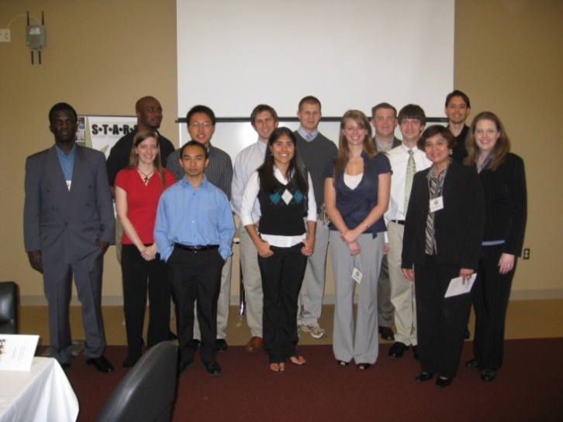
STARS Computing Corps
National alliance funded by NSF
College students and faculty to become leaders who broaden participation through:
Service,
Research,
Outreach in colleges and K12 schools
NCSU STARS
Notes:
NCSU was one of the 8 founding schools in this alliance, that now reaches over 50+ school.

Slide 8
Georgia Computes!
Funded 2006-2012 by the NSF BPCA program
Curriculum based on Guzdial’s Media Computation Course [Ericson, 2007]
Motivating learning CS in grades 4 - 12
Through creation of weekend workshops & summer camps
Professional development for educators
Notes:
Across 19 campuses
We know of only one eort to measure progress
on computing education goals (e.g., diversity, retention, and
transfer from two-year to four-year programs) of a whole
state, inMassachusetts through the Commonwealth Alliance
for IT Education (CAITE) [1].
AP CS training since 2005 (c++ to java transition)

Slide 9
Middle school: CS???
Guzdial’s 2012 statewide survey on computing in GA,
1400+ introductory computing students
19 higher education institutions
CS students prior experience:
57% took computing in high school (69% programming oriented)
28% participated in computing in middle school
57% weren’t aware of computing in middle school
Notes:
Across 19 campuses
18 % were aware but chose not too MS
1% boy scout, 1% girl scouts
69% of classes were programming oriented

Slide 10
Getting more CS students
Georgia Computes! research showed:
For underrepresented groups, encouragement mattered more than ability [satisfaction & likelihood to pursue]
Results indicate that improving outcomes … entails improving
affiliation with the computing community and
enhancing the relationship between activities and student interest [Guzdial, 2012]
Notes:
Across 19 campuses

Slide 11
GC Middle School Workshops
On college campus, $30/session (3 hrs)
Taught by local business teachers “trying out” new CS tools
2000 students in K12 outreach activities 2006-2012
GA Computes activities had little impact at the middle school level,
Only 1% participated in Boys & Girls club workshops
Only 1% participated in Girl Scouts workshops
Notes:
Across 19 campuses
40 students * $30 -> 1200
Elementary $285 (300), HS $185 (200)
14 students.
36% of shools w/ ice teach prodcued 56.97% of intro cs students

Slide 12
SPARCS: Oct 2007
Students in Programming, Robotics, & Computer Science
Goals:
Raise awareness of and interest in computer science
Increase number of students taking CS courses in HS
By:
FREE Hands-on computing program @ Middle Schools
Taught by passionate STARS computing majors (role models)

Slide 13
Hypotheses
Students are more interested in learning about (or through) current or familiar technologies
Students who feel confident in their abilities are more likely to persist in an activity
The changes made over the years to improve the program will result in an overall increasing enjoyment level, while showing decreasing attrition rates

Slide 14


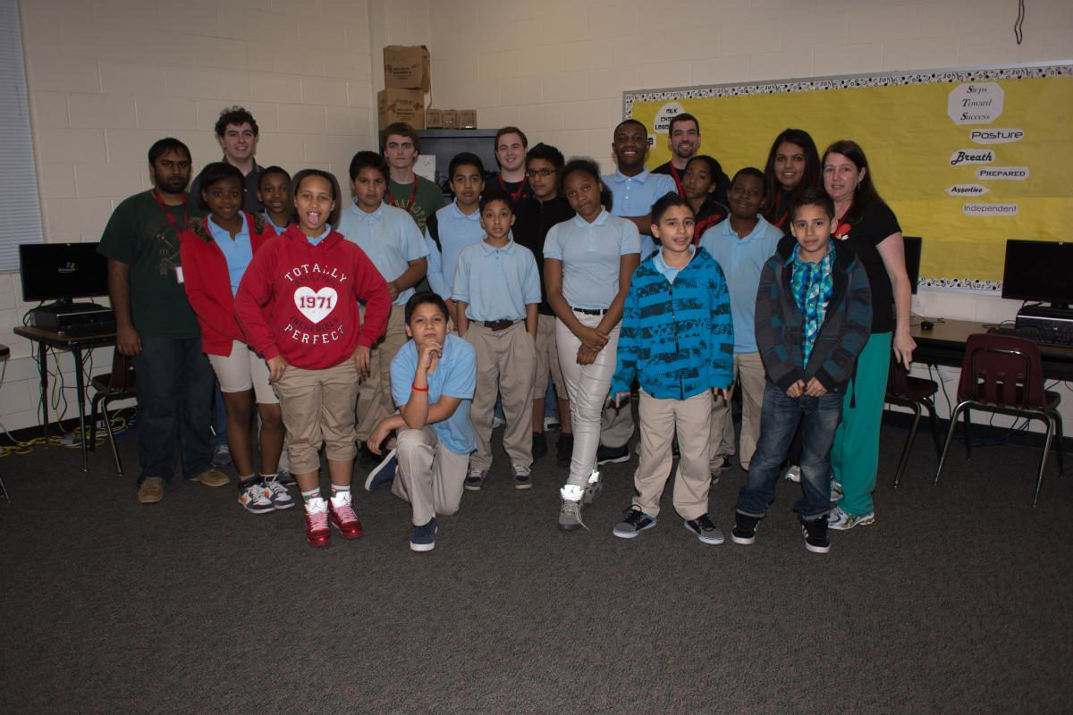
About Us
As part of STARS, 4-5 college students in teams develop and deliver outreach curriculum
6 Locations:
Magnet Middle School – CCMMS (now 3 grade levels)
All Boys Academy – DNS lower SES
The Academics – Math & Science Education Network @ UNC Charlotte & NCSU
The Disadvantaged – MMS, MLK MS
Notes:
I’m the regional coordinator of 6 SPARCS programs,

Slide 15
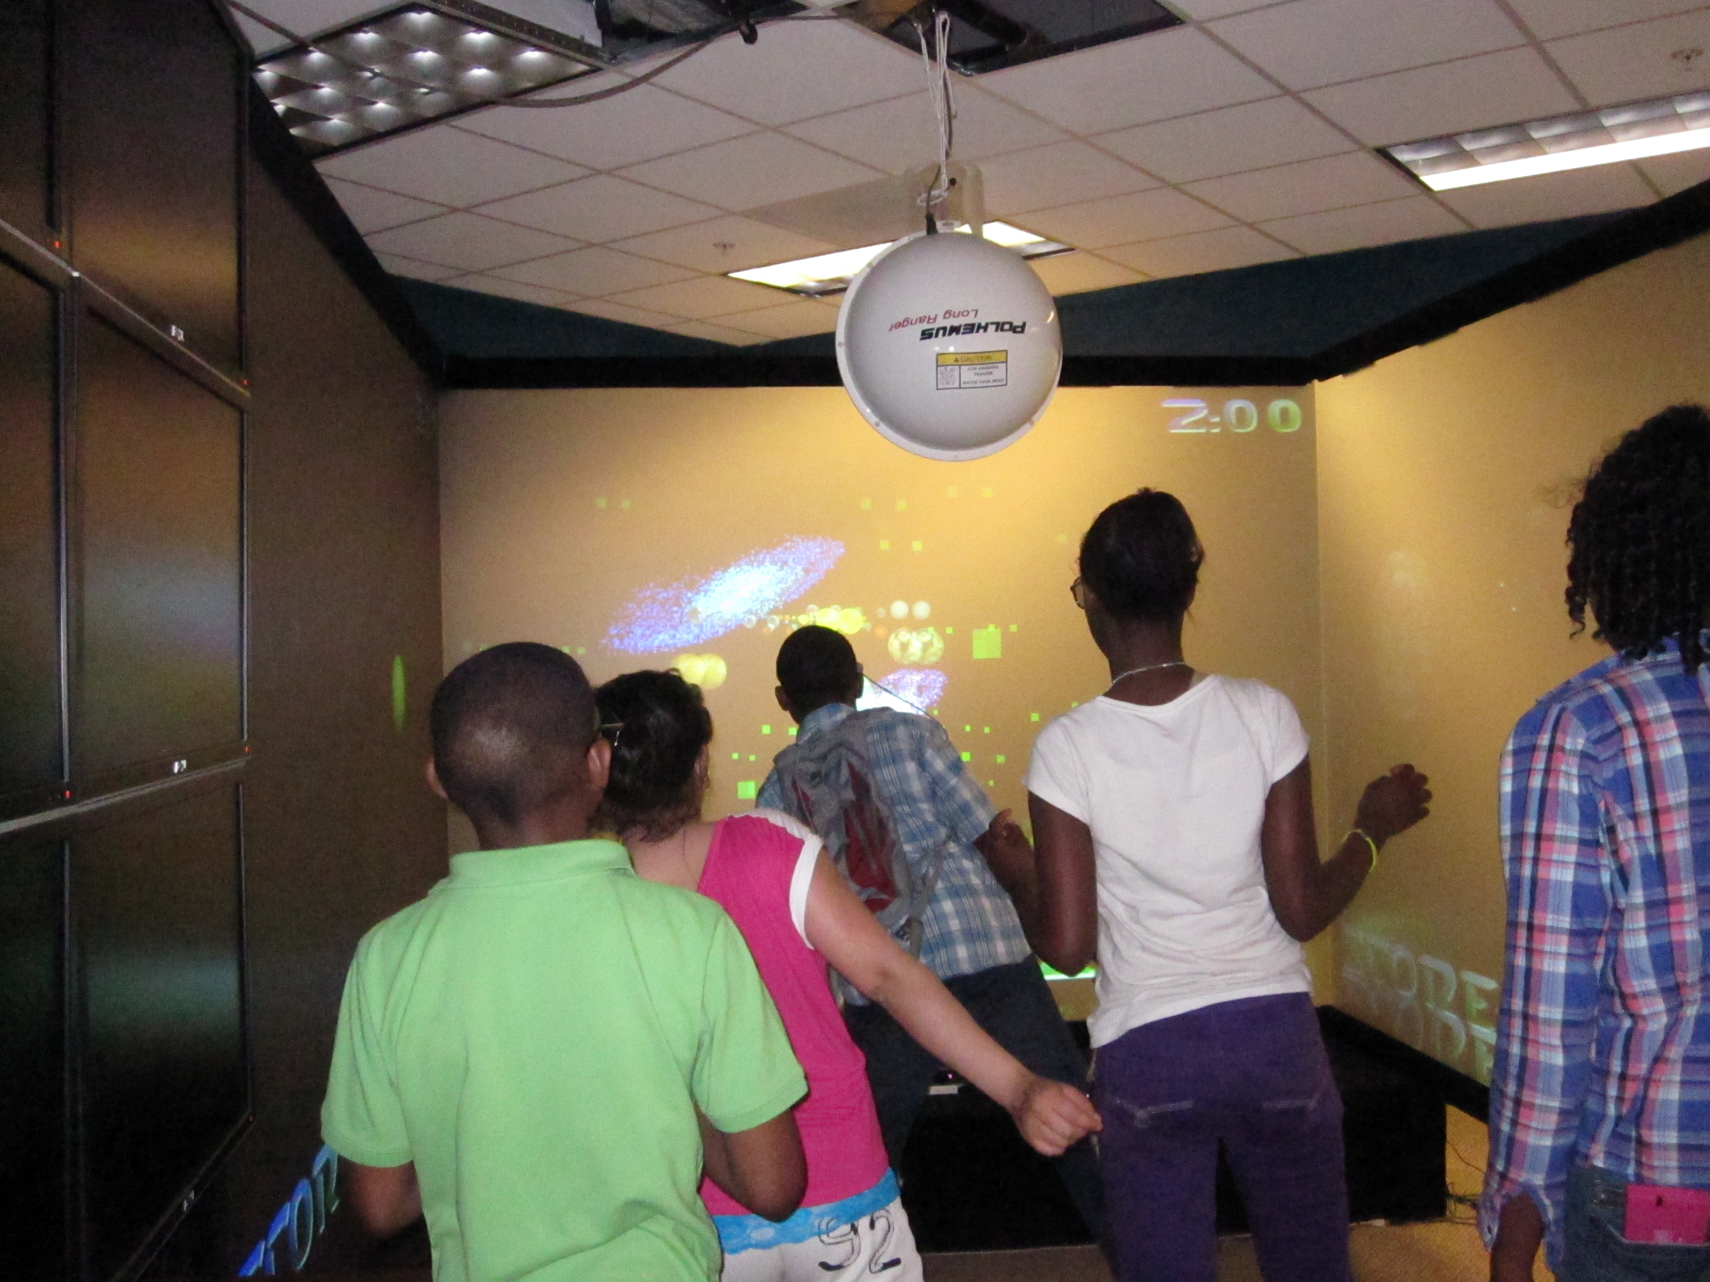
Sessions
One Saturday a Month
4.5 hour sessions
Each session is a new topic
Easier fit for schedules
One Day a Week
1.25 hour sessions
Topics split into 3 week groupings
Fits after school program, but participants might not make every session in a series
Notes:
why did you choose this amount of time for curricula? What do you think would happen if they were shorter/longer? Why do students choose these?
Saturday 10:00am – 3:00pm (like a school day) move slide 52 to after this one
Fridays w/o teacher in room is hard to manage

Slide 16
Sample Lesson Plan: Web design
Opener – Arrival & Pre-surveys (30 mins)
Lesson (Slides) – Introduction to Web Design (20 mins)
Tutorial – Basic Webpage Walkthrough (60 mins)
Gym – HTML Tag (30 mins)
Lunch (until leaders recover, 30-45 mins)
Challenge – Website Design Competition (90 mins)
Play Testing/ Demos (15 mins)
Closing – Post-surveys (10 mins)
10:00am-3:00pm
Notes:
It is nice to have an activity for people who arrive on time

Slide 17
Non-Formal Learning
Used most often to describe organized learning outside of the formal education system
Offerings tend to be short-term, voluntary, and have few if any prerequisites
Typically have a curriculum and often a facilitator [Merriam, 2007]
Notes:
SPARCS follows Merriam’s definition of non-formal learning where learning happends outside the formal education sytem
These learning sesions tend to be short term, vvoluntary, and have few prerequisites
However, they do typically have a curriculum and a facilitator

Slide 18
Non-Formal Learning
Research rooted in constructivist, constructionist, and culturally relevant learning theories has long emphasized
Importance of connecting instruction to students’ interest and prior knowledge
Using active and collaborative learning pedagogies
[e.g.,Vygotzky, 1978; Papert, 1980; Harel & Papert, 1990; Harlen, 1998].
Notes:
A wealth of broader educational research rooted in constructivist, constructionist, and culturally relevant learning theories has long emphasized the importance of connecting instruction to students’ interest and prior knowledge and of using active and collaborative learning pedagogies (e.g.,Vygotzky, 1978; Papert, 1980; Harel & Papert, 1990; Harlen, 1998; Ladson-Billings, 2006)
This research highlights how these approaches are important not only for improving learning for girls and other underrepresented students, but for all students.

Slide 19
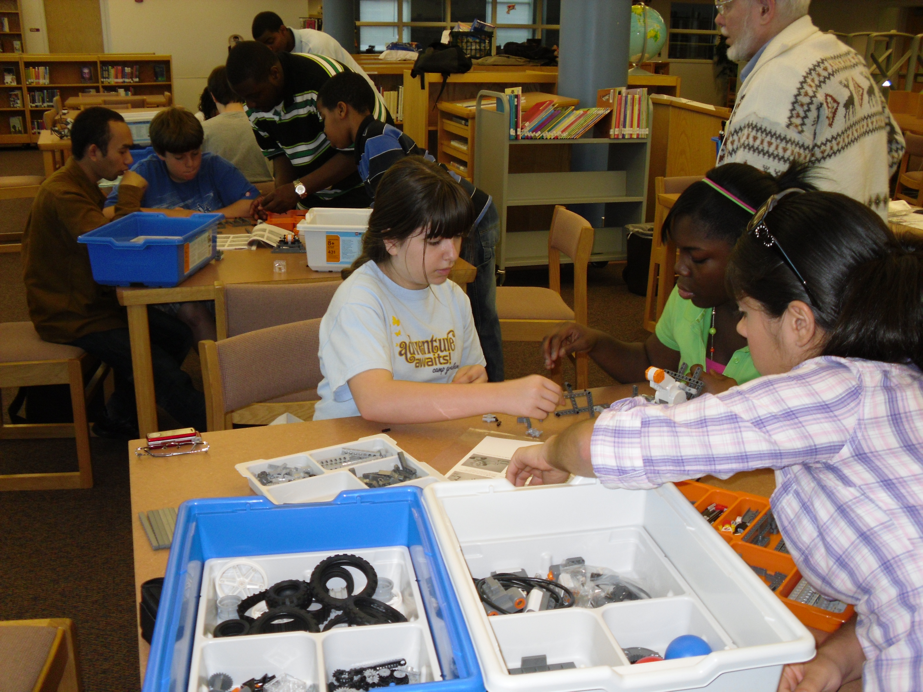
Beginnings, 2007
We started with 13 students @ CCMMS
CS Unplugged,
2 Alice sessions, &
2 Lego Mindstorm Robots sessions
Field Trip to Science Center
Notes:
Talk about activities (alice minstorms
CS Unplugged university of canterbury, google.

Slide 20



CS Unplugged
A collection of free learning activities that teach Computer Science through puzzles, physical activities, and games
Our Topics: Programming Languages, Binary Numbers, Sorting Algorithms, Artificial Intelligence, Finite State Automata

Slide 21
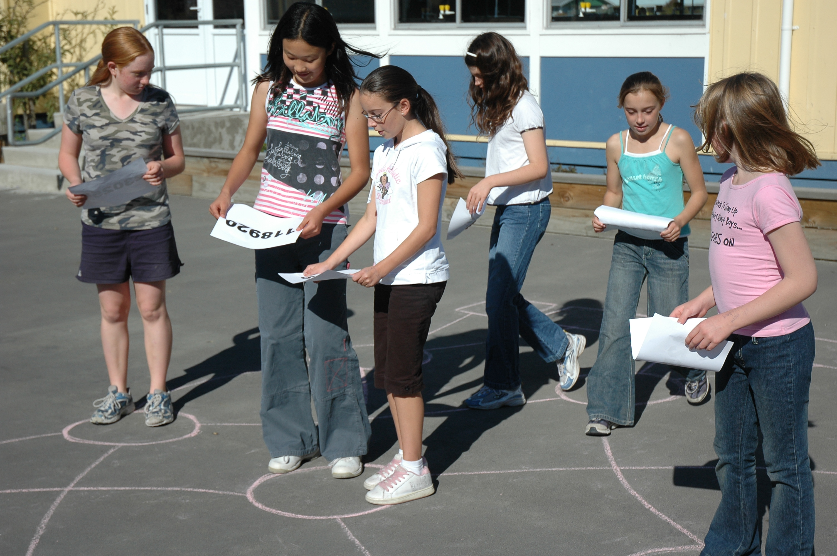
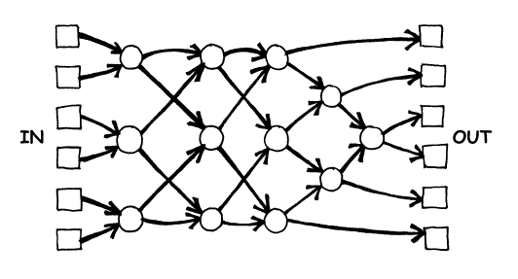
CS Unplugged Example
Sorting Networks
Notes:
Students compare efficiency of sorting networks with other sorts, bubble sort, insertion sort, binary tree.
(best, random, worst case scenario)

Slide 22
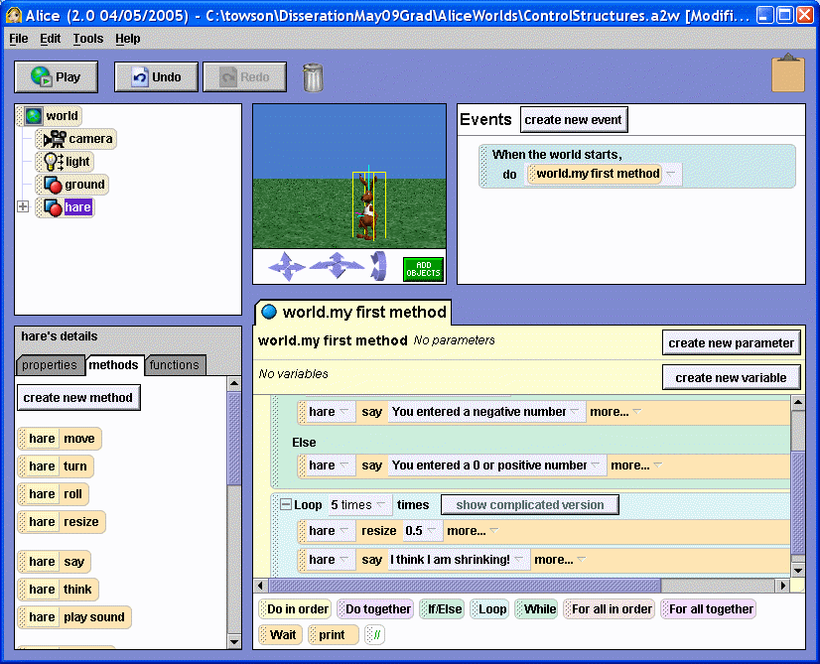
Story Time Alice
3D programming environment to create animations & video
Drag and drop tiles
Lessons: Engineering Design Cycle, Object Oriented Programming

Slide 23
Alice Lesson Overview
Lesson Topics: Intro to Object-Oriented Programming, Intro to Alice environment
Learning Outcomes:
Students are comfortable working with Alice
Students know how to create program plans
Students can describe the parts of a program and why they are important
Students can define: method, function, object, and attribute
Notes:
In this session we will learn about the steps to take when creating a program and why they are important. We will also learn about the fundamentals of object oriented programming and how it works in the Alice programming environment.
Read understand, design, implent, test, revise

Slide 24
Rationale
Extends upon the last session where students learned basic concepts about how a computer “thinks”
Students should understand what kind of instructions they need to give
Sets up for the next session, where they learn more advanced programming techniques
Notes:
Programming languages, very explicit
Know when to stop and start
Only know about things that have been defined

Slide 25
Schedule
10:00-10:30: Wait for kids / pre-surveys
10:30-11:15: Alice tutorials (provided with Alice)
11:15-11:45: Snack, games in gym
11:45-12:45: OO presentation – how to make a cat in Alice
12:45-1:30: Lunch
1:30-2:30: Steps for programming ppt /storyboard/implement
2:30-3:00: Post-surveys/wrap-up
Notes:
Methods vs properties

Slide 26
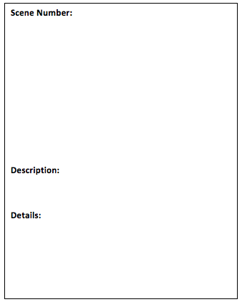
Strategies and Procedures
Focusing Activity/Ice Breaker
Alice tutorials, as provided with the program
Teach about the storyboard worksheet
Students fill in worksheet (alien invasion)
Teach objects, methods, attributes etc.
Students create the program they develop on their storyboard
Notes:
See what people remember from last time, “what is a program” “why do computers need exact instructions”
Read Understand, Design, Implement, Test, Revise.
Go over each of those in conjunction with storyboard example (zoo)
Students identify the object, methods, etc in their own storyboard
Do an exercise where after they have created a plan, they circle the objects and list the methods and names of the properties for each object
Encourage students to download Alice at home and create more with it
Emphasize importance of planning your programs before Alice

Slide 27
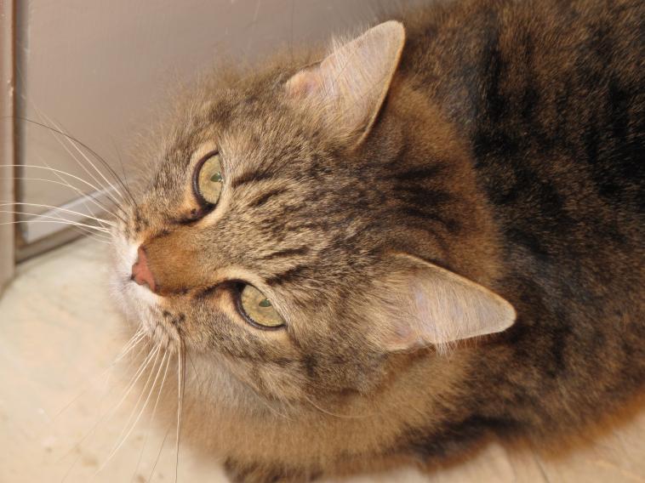
Example: The Cat Class
What methods would a cat have?
eat
purr
meow
What properties would a cat have?
name
color
age
These methods and properties define the Cat class.

Slide 28
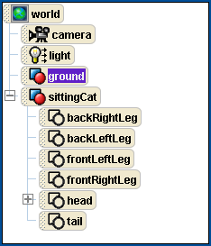
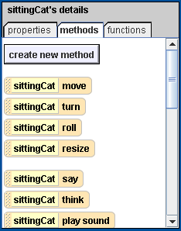
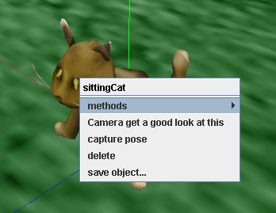
Objects in Alice
ALICE lists all scene objects in the upper left panel.
ALICE lists all methods and properties of the selected object in the lower left panel.
You can try methods by right-clicking on an object in the scene or the object list.

Slide 29
Alice 2: Programing Concepts
10:00-10:30 Wait for students to arrive/pre-surveys
10:30-11:00 Review Activity: Make a person class.
11:00-11:30 Game in Gym/Snack
11:30-12:30 Control Structures Presentation / Ball Activity
12:30-1:00 Lunch
1:00-2:45 Activity: Finish Bouncing Ball, Do Ice Skater activity
2:45-3:00 Post Surveys
Notes:
Review Questions: what is a class, methods, properties? What methods and properties would a person need?
Walk through ball activity as a class. Asking what do we need to do? How would we go about doing this in Alice? And then walking through the steps together.

Slide 30
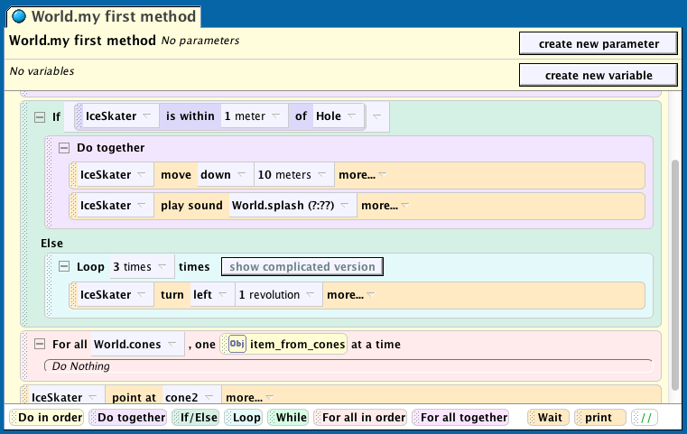
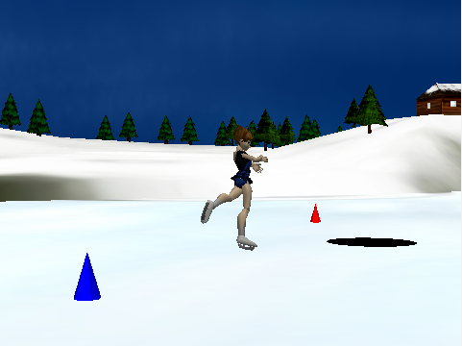
Alice Skater
learn about advanced control structures
if/else statements,
loops,
conditionals
and lists

Slide 31
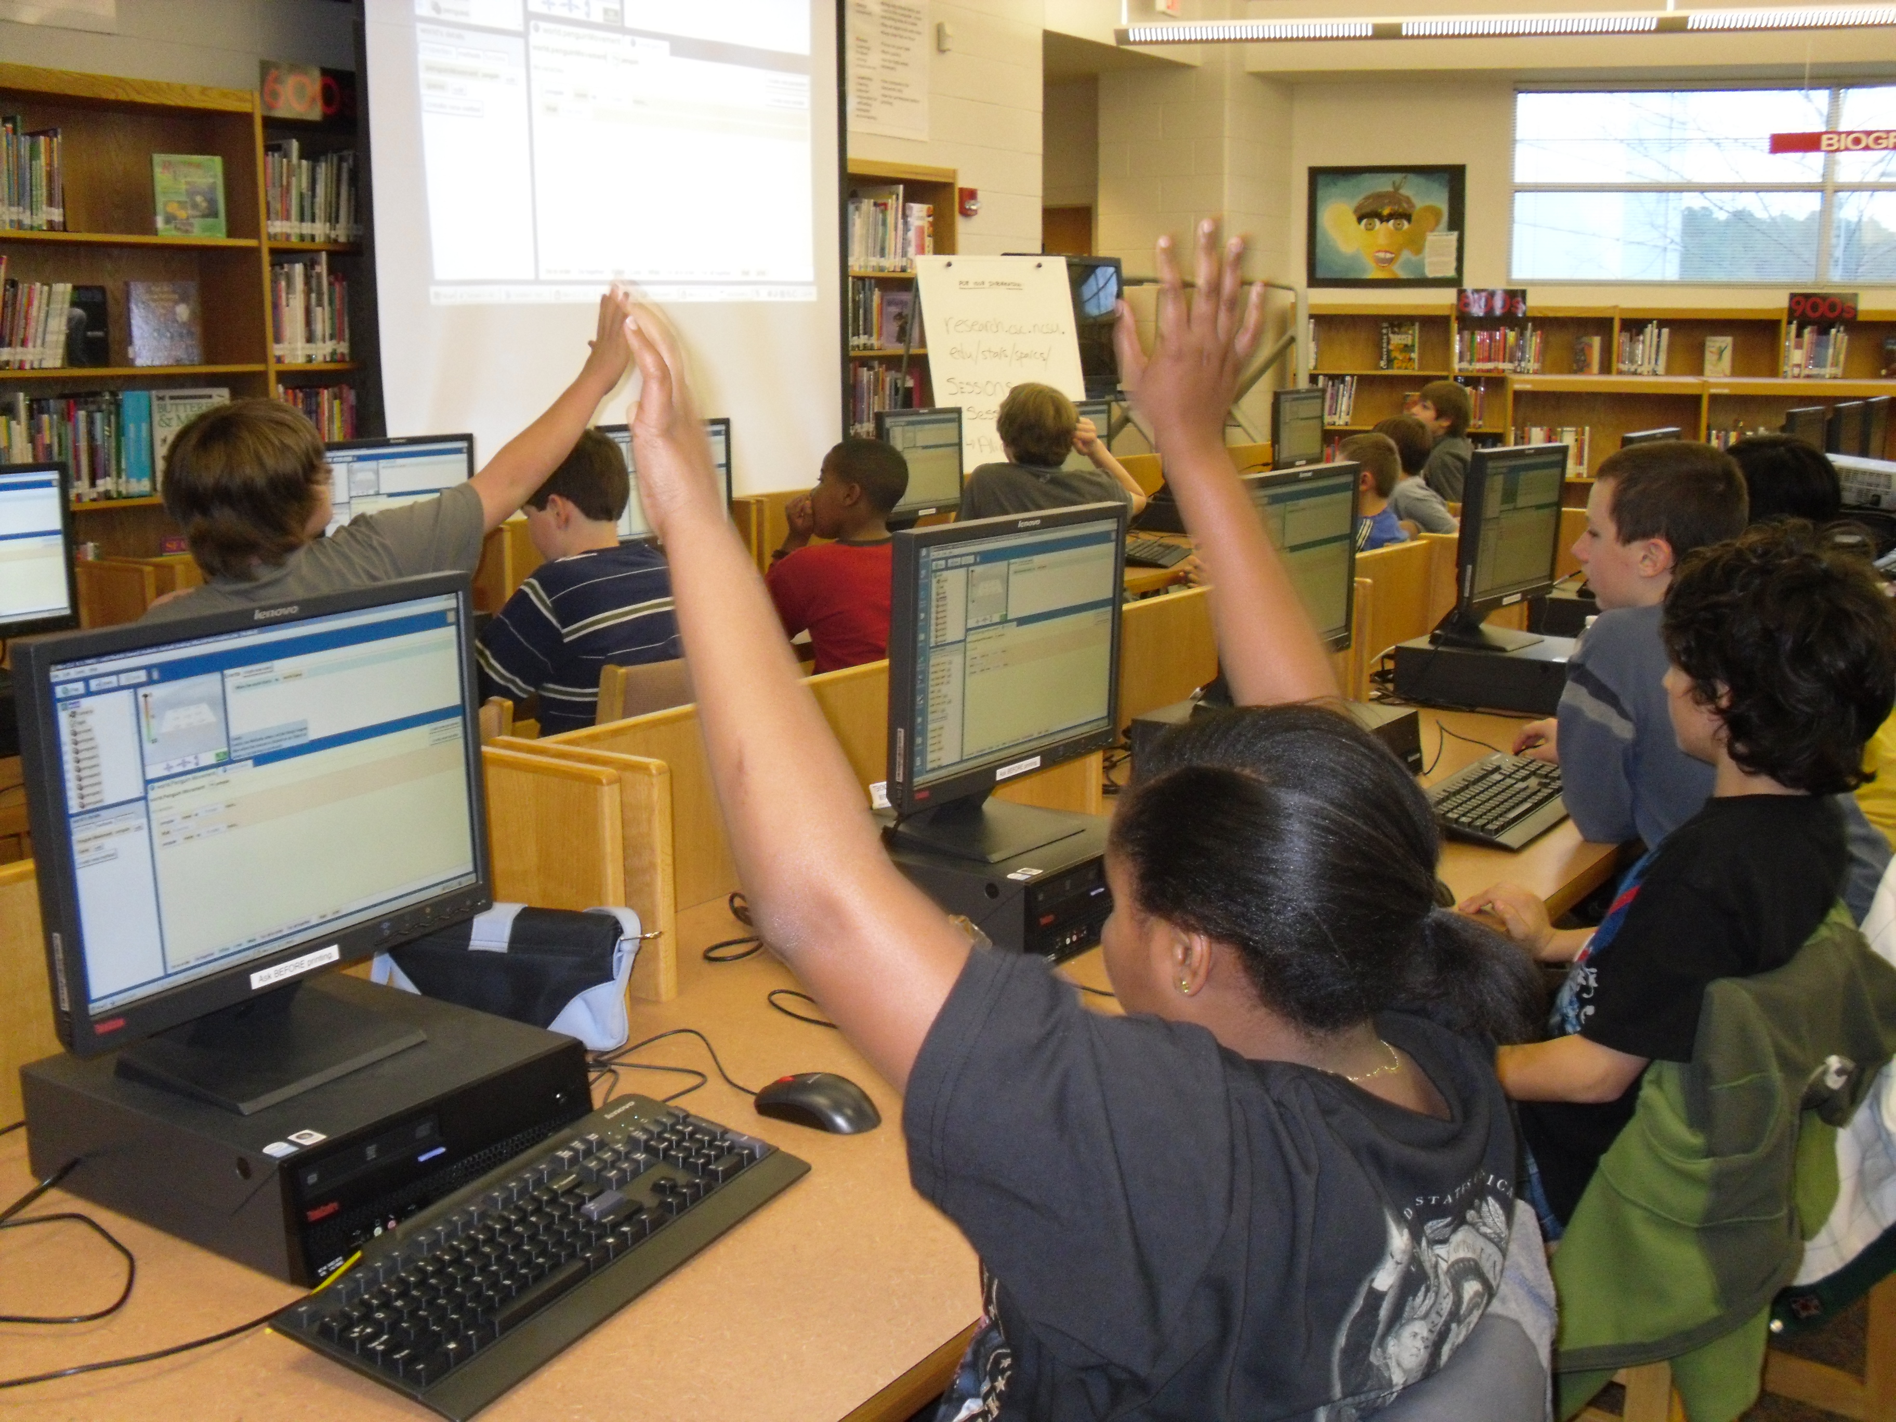
Evaluation & Feedback
Pre/Post surveys
Storyboards
Teacher Feedback

Slide 32
Online Surveys
Provided a way to track student attendance
Get a basic understanding of student knowledge coming in
Check learning differences at end of day
Sample Question from Alice 2 Pre-Survey
Do you know what a loop is in computer programming?: *
Definitely Know
Probably Know
Might Know
Probably Don't Know
Don't Know
If YES, please describe what a loop is and how it is used:

Slide 33
Online Surveys
Pre Surveys were typically 5-6 questions on material being covered that day
Post Surveys had the same questions, plus attitudinal questions
Did you learn new things today?: *
Learned a lot!
Learned some
Learned a little
Didn't learn
Did you like this session?: *
Liked it a lot!
Liked it some
Liked it a little
Didn't like it
Hated it
What is the coolest thing you learned today?: *
What was your favorite activity: *
What was your least favorite activity: *
*Note: As surveys were designed to be part of the program and not for research, no IRBs were originally submitted. Parental permission was given at time of registration

Slide 34
Alice Reception
Students reported lower enjoyment of Alice 2
The current session was too difficult
Students wanted to make more games in Alice
Winter Break
Notes:
The first major dip occurred after Alice, then again after winter break
Security dip - > winter break
Fix numbers.
With this new infrastructure we were able to see the relationship between ratings and attendance
+ additional logistic issues

Slide 35
Survey Feedback – Alice
First Alice Session, n=14/16
Second Alice Session, n=12/17
Notes:
15+32+17 good
9+7 bad
87%
6+30+7 good
5+12 bad
83%

Slide 36
Student Knowledge, Alice
Notes:
Charts out of 4.5?
Ordinal Data
1st alice avg confidence, 3.5 -> 3.46
2nd Alice, 3.2 -> 3.216

Slide 37
Curricular Changes
Teacher feedback
Students wanted to make more games
Not sure if students learned what they were supposed to
Notes:
Security & Web added in 08-09
Alice Whack a mole added in 2009-2010
Game Maker added in 2010-2011

Slide 38
Hypotheses
Students are more interested in learning about (or through) current or familiar technologies
Proposed to create a new game based lesson in Alice
Whack a Mole

Slide 39
Whack a Mole
Properties: Penguins, Score, Clicked, Current Penguin
Methods: Make a penguin come up, get a random penguin, check game score
Steps:
get a random penguin
move the random penguin up
wait
move the random penguin down
Notes:
List of Penguins
isClicked boolean value
Index, current penguin
Score variable
GameLoop,

Slide 40
Methods
Check Game Score
check that the item that was clicked was the right penguin and that it hasn’t been clicked before
if true update the score, move the slider down, clicked == true
else do nothing
Get Random Penguin
set the current penguin to a random penguin from the penguins list
set clickedOnce to false

Slide 41
Games with Alice
Notes:
Security & Web added in 08-09
Alice Whack a mole added in 2009-2010
Game Maker added in 2010-2011
08-09 N=12
09-10 N=11
Post test to post test T-Test over the score
Lesson Learned for designing curriculum for novices: games give a good concrete context in which to learn abstract concepts

Slide 42
Hypothesis
Students are more interested in learning about (or through) current or familiar technologies
Enjoyment and learning measures were both higher
Students who feel confident in their abilities are more likely to persist in an activity
Attrition rose to 60% during this year, Previously ~45%
Likely due to extended time gap between sessions

Slide 43

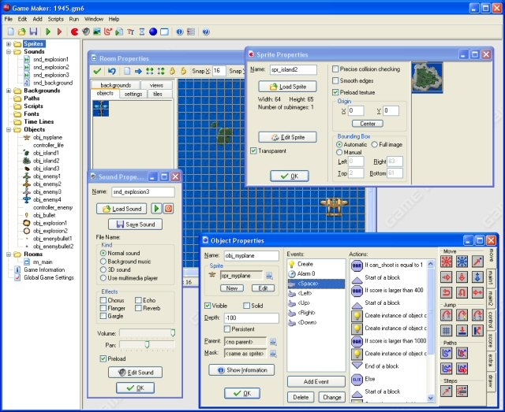
Curricular Changes
Can we use game design to teach Object Oriented Programming as well as Alice?
*New* Game Design w/ Game Maker ☺ ☺
Notes:
Security & Web added in 08-09
Alice Whack a mole added in 2009-2010
Game Maker added in 2010-2011

Slide 44
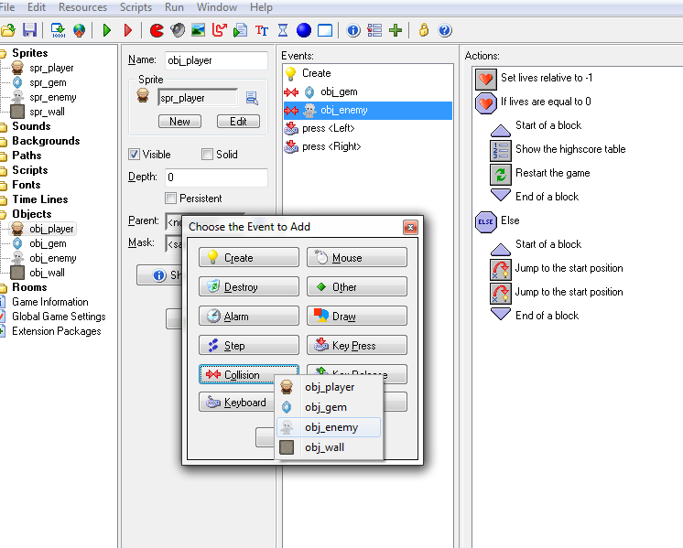
GameMaker
Objects: Player, Enemy, Gem
Methods: Move Left, Update Score, Check Collision
Properties/Attributes: Score, Health, Time, Speed

Slide 45
GameMaker vs. Alice
Notes:
Confidence in knowledge has increased
Enjoyment and Learning remain Similar
Alice 1 N=11, GameMaker N=13
Gm Avg 4.18,
Alice Avg 3.85
----- Meeting Notes (10/15/14 15:48) -----
difference between the means/ standard deviation
effect size.

Slide 46
Hypotheses
Students are more interested in learning about (or through) current or familiar technologies
Students who feel confident in their abilities are more likely to persist in an activity
Attrition cut in half, by introduction of mid year GameDesign Lesson

Slide 47
Now…
CSUnplugged (+Rubiks cube algorithms)
Web Design (html5 canvas, Twitter Bootstrap CSS, html)
Game Design (Kodu, Unity3D, Photoshop, Google Sketchup, Scratch, GameMaker)
Security/Encryption
Mobile apps (Windows, Android, iPhone)
Circuitry (Minecraft)
Robotics (Mindstorms, Scribbler)
NCSU Only
UNCC Only
NCSU&UNCC

Slide 48
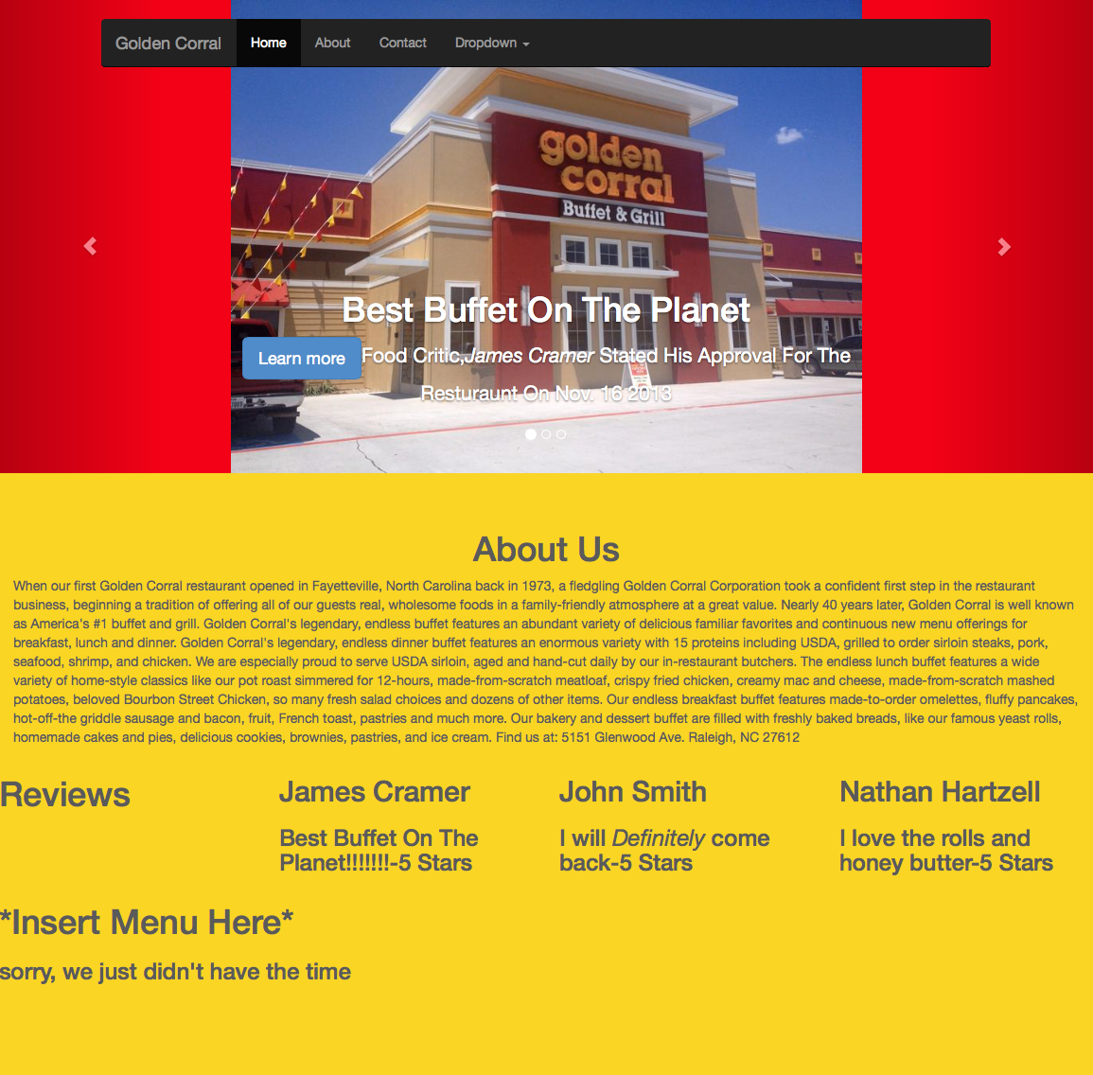
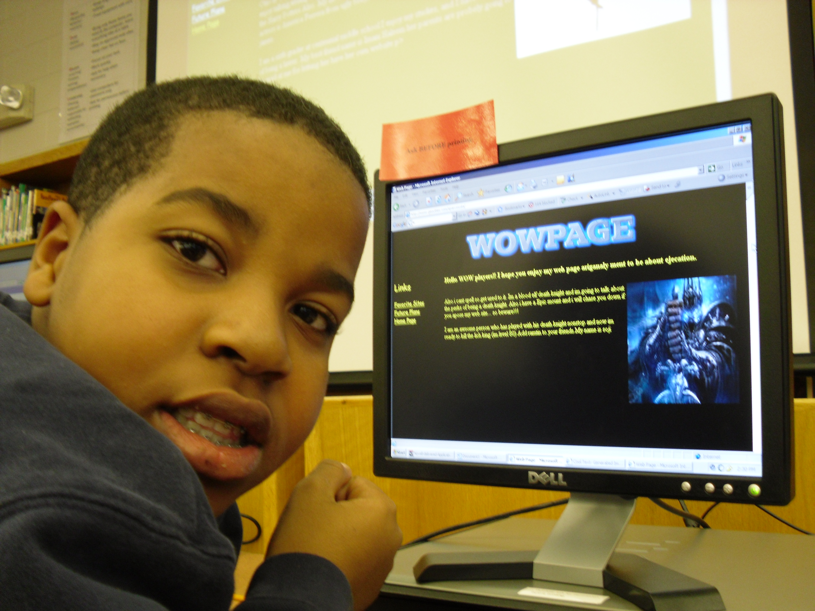
Returning Students & Advanced Artifacts
Foundations in place,
Returning students do advanced curriculum
From HTML tags to Bootstrap
Notes:
HTML limitations – no time to teach css, so it’s text and a picture and that’s it. Also behaves strangely on mobile.
Twitter Bootstrap – code templates guarantee functionality on mobile/tablet/computers. Also allows for easy placement of elements too complex for quick html lesson (revolving carosel, dropdown menus). One team had enough extra time to embed google maps to show the exact position of their restaurant.

Slide 49
Hypotheses
Students are more interested in learning about (or through) current or familiar technologies
Students who feel confident in their abilities are more likely to persist in an activity
The changes made over the years to improve the program will result in an overall increasing enjoyment level, while showing decreasing attrition rates

Slide 50
Results
Students had higher enjoyment in sessions on or involving:
Video Game Development
Mobile App Development
Web Page Development
Students would return following years to do the same material,
Either at a deeper level, or in a new/advanced tool

Slide 51
Comparison of “familiar” tech enjoyment
Student enjoyment was highest in sessions that utilized familiar technologies
Video Games
Web Design
Mobile Applications
Notes:
----- Meeting Notes (9/24/14 15:27) -----
How alice isn't neccesary relevant.
GAme maker interface is more familira interface, drag and drop
backwards
relevance to the kids
How often do you do each of the follwoing
n, and likert conversion

Slide 52
“Familiar” tech hypothesis results
Concrete mediums, not abstract concepts
More intuitive goals
Less learning curve for interface

Slide 53
Survey & Retention Results
Student level of enjoyment has increased, while retention rates are steadily increasing
Notes:
Attrition (2009) December 2009 2 month Gap
@ risk this year for gap from snow storm.
Fun 2011, 2012 ?? Students just weren’t as enthusiastic
Friday attendance 15–10, Saturday 7-7

Slide 54
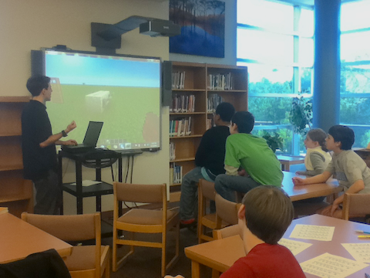
Conclusions
By creating an accessible curriculum that incorporates enriching hands on learning experiences using familiar technologies,
We can better engage students which leads to higher retention rates

Slide 55
SPARCS Middle School Student Alumnus
“Our work with Alice caused me to pursue learning Java as my first self-taught language. Mostly, though, it simply kept me interested in STEM topics during a time when I academically couldn't afford to focus as much on those hobbies. Without SPARCS, I may have lost interest in such fields too early.”
– SPARCS Alumnus
Notes:
80% of sparcs students take cs in hs
6% of montgomerey county students take CS
43,000 kids in HS wake county

Slide 56
Tracking Program
Sent SPARCS alumni follow up survey
52% of alumni responded (out of program 2-5 years)
80% of those, reported taking at least 1 CS class in HS
Many of them taking up to 3

Slide 57
Publications
Peer-Reviewed Conference Publications
Hicks, A., V. Catete, T. Barnes. (2014). “Part of the Game: Changing Level Creation To Identify and Filter Low-Quality User-Generated Levels.” FDG 2014.
Catete, V., K. Wassell, T. Barnes. (2014). “Use and Development of Entertainment Technologies in After School STEM Program.” SIGCSE 2014.
Powell, E., R. Brinkman, V. Catete, T. Barnes. (2012). “Table Tilt: Making Friends Fast.” FDG 2012.
Extended Abstracts & Posters
Olaya, J., D. Hicks, V. Catete. (2012). “Teaching Concepts through Educational Games Using Social Aspects Within Peers.” SIGSCE 2012
Sabourin, J. V Catete, M Draelos, et al. (2011) “SPARCS Middle School Outreach.” Poster at STARS Celebration 2011, 1st place Outreach Poster
Draelos, M., V. Catete, O. Estrella et al. (2011). “Digital Logic Lesson Plan for Middle School Outreach.” Poster at STARS Celebration 2011, 2st place Outreach Poster
Catete, V., J. Sabourin. (2010). “Examining Facial Expressions of Emotion in Narrative Centered Learning Environments.” Poster at STARS Celebration 2010, 1st place Research Poster
Catete, V., J. Sabourin. (2010) “Designing & Building a Pressure Sensitive Seat.” Poster at NCSU Poster & Pies SRC
Catete, V., D. Lauck, M. Draelos, S. Lam. (2009). “SPARCS Middle School Outreach.” Poster at STARS Celebration 2009

Slide 58
Thank you!
Veronica Catete
vmcatete@ncsu.edu
Advisor: Tiffany Barnes
tmbarnes@ncsu.edu

Slide 59
Notes:
Case Study->
Design iterations over a particular session
Compare learning objectives -> game maker to alice
Here is something we know a lot better since we went through the iteration
Less time on motivation
Less time on related works
Emphasize better other non-formal learning programs us vs georgia computes!
Slightly deeper level how ours is better
Ground work in informal learning literature
Can’t get students to do a thing unless their interested
STARS proposal informal such
Surveying attitudes in e-learning papers on piazza
Attitudes of instructors on adoption
C in Ed future.
There’s no women
I made a oct 2007 program
This is a presendtaion on the design iterations
This is a focus on on the oop and game design curriculum
Started with Alice
Saw low enjoyemtn
Switched to games
Switched to GameMaker
Last slide here’s things I’m thinking on working on with this information

Slide 60
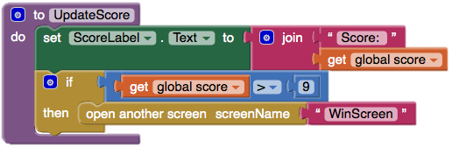
Cognitive Questions
Based on the Code snippet above, which of the following is true about the procedure "UpdateScore”?
Update Score changes the value of global score
Update Score will do different things based on the value of ScoreLabel
Update Score will do different things based on the value global score
Update Score moves the Mole to a different position on the screen
What happens when the global score reaches 9?
The system displays a WinScreen
The ScoreLabel is updated to "Score: 9”
The ScoreLabel is updated to "Score: 9", and then the System displays a WinScreen
Nothing

Slide 61
Free Response Questions
Imagine you are making a game with a CAR object. List three (3) properties and methods that a CAR might have
Name the simplest from of encryption we talked about today and describe how it works
Convert the following numbers from binary to decimal
00101:
01010:
11001:
10000:
Why is it important in Computer Science to understand how people think?

Slide 62

IRB Approval
Initial SPARCS Surveys under STARS umbrella
2012 we formally submitted to IRB for use of SPARCS data (we’re exempt)
2014 we received IRB for surveying SPARCS alumni (students in HS grades 9-12)

Slide 63
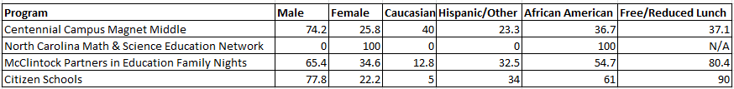
Demographics
Percent demographics by group

Slide 64
Phases of Curriculum Development
Phase | Years | Objective
Phase I | 2007 – 2009 | Test to see if students are interested
Phase II | 2009 – 2011 | Build student retention via infrastructure & evaluations
Phase III | 2011 – 2013 | Introduce mainstream technologies, games, mobile apps, etc.
Notes:
Sample Questions, Thought they learned vs actual learned
Raise interest, recruit new students, and retain old ones

Slide 65
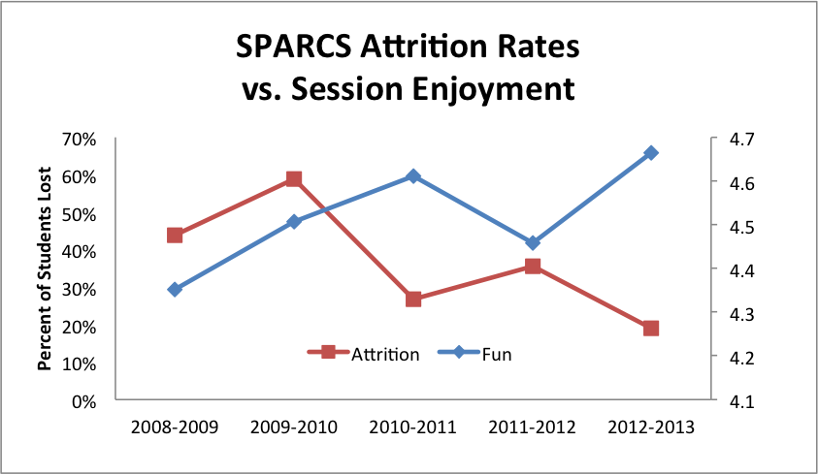
Years that don’t meet hypothesis: 2009, 2011
High attrition in 2009 caused by a two 2 month gap in sessions over winter break
We are unable to explain the dip in fun in 2011
Sessions were overall underrated
Same mentors between years
NO clear reason
Notes:
@ risk this year for gap from snow storm.
One theory is discipline might have been an issue this year, one student who purposely wrote jibberish and failed scored everything could have affected the overall learning atmosphere
Graph lower session rating
Sessions were overall underrated
No needle in the haystack

Slide 66
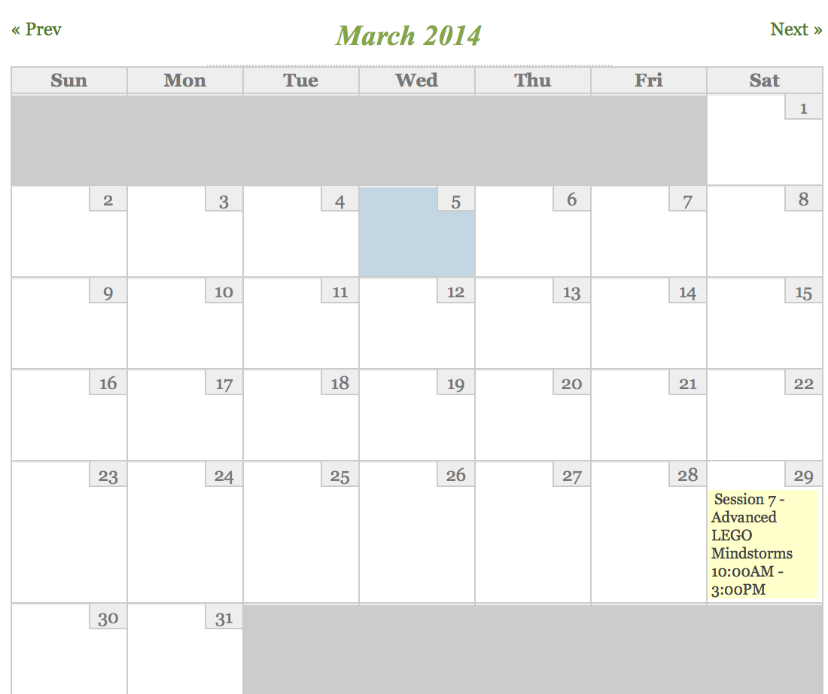
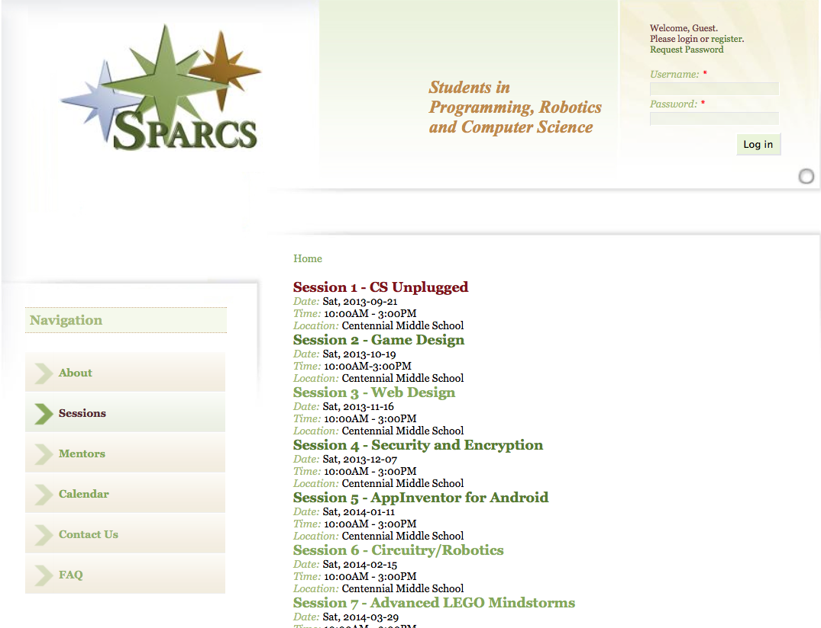
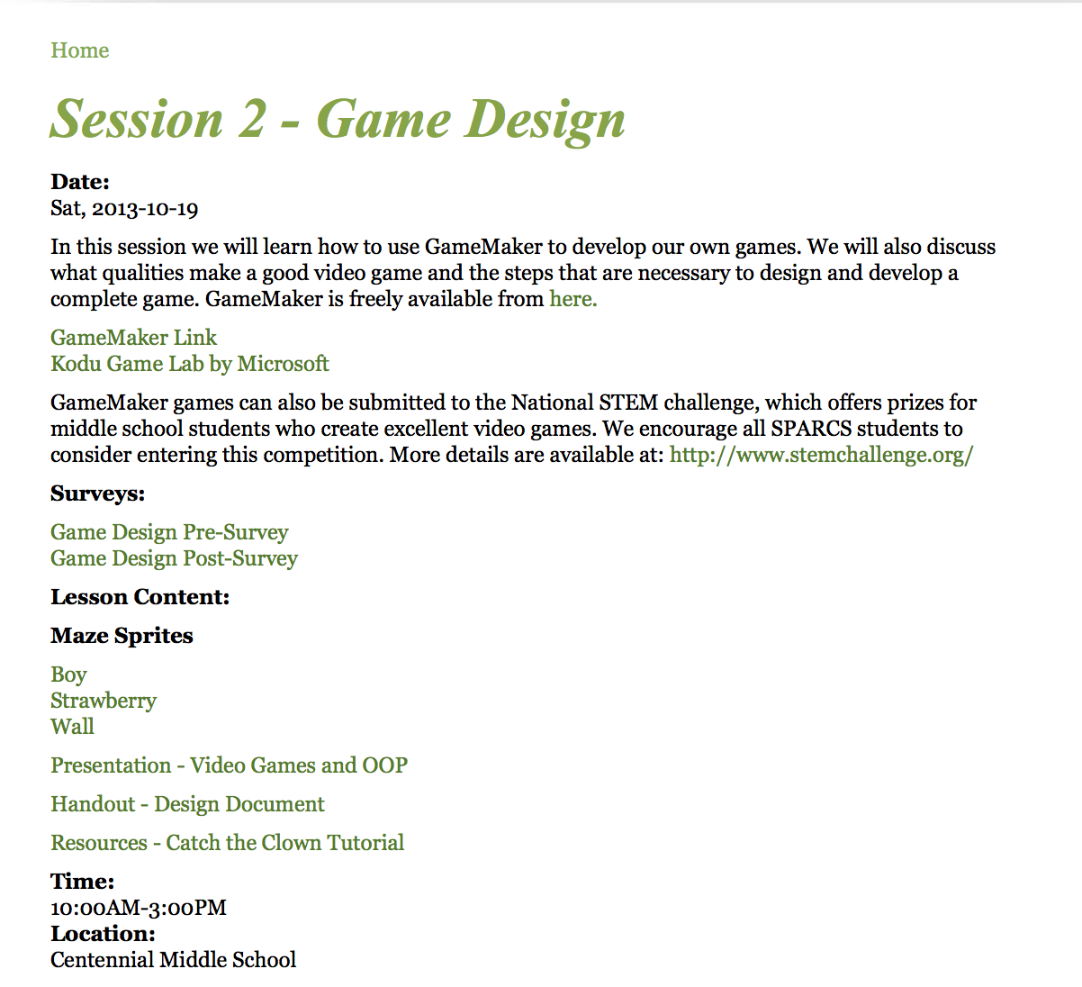
Website - Drupal

Slide 67
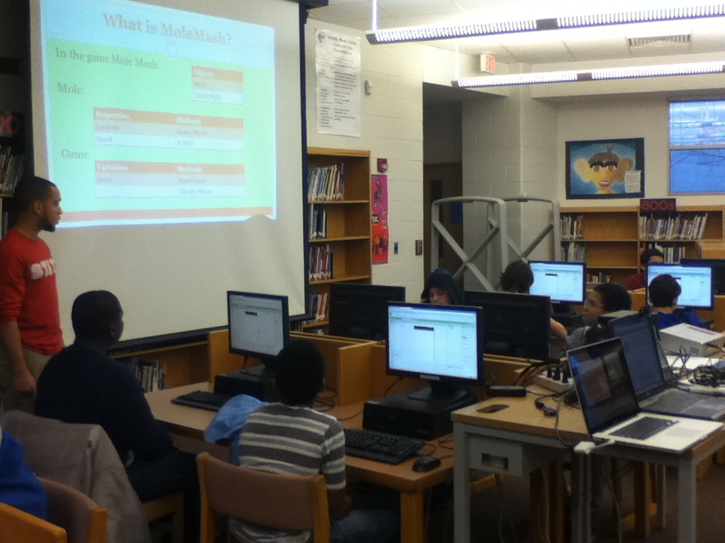
Phase III: 2011-2013
Circuitry Revisited
PowerPoint slides
Logic gate worksheets
*New* Redstone circuitry at minecraft.net
Notes:
New types of activities - > why were they selected
Why switch to minecraft
Youtube of child doing circuits
Needed more content to boost interest

Slide 68
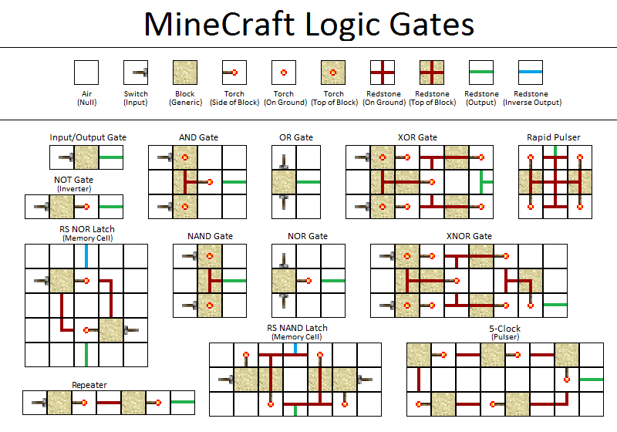
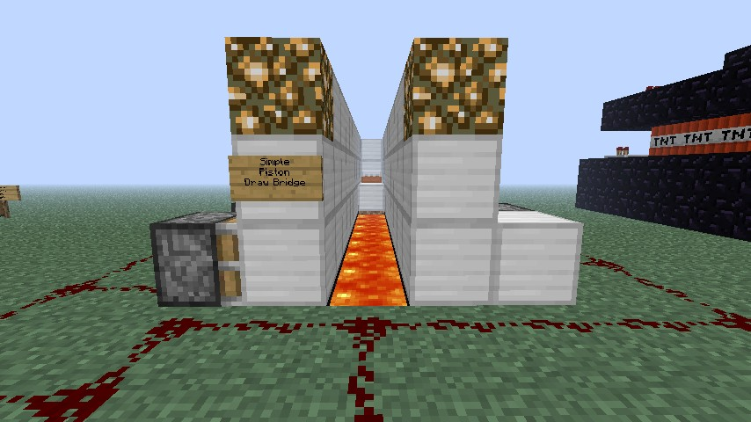
Notes:
16 bit algorthim and logic units

